Slide 1
Real Estate Market Analysis
Presented by-
P. Srivani
Batch No. 546

Slide 2
Agenda
Business Problem
Problem Statement
Project Objective
Project Flow
Dataset Overview
Project steps and screenshots
Business Insights and Recommendations
Conclusion

Slide 3
Business Problem
The real estate market in Hyderabad offers a wide range of residential properties with varying prices, sizes, BHK configurations, and property types. However, comparing these properties and identifying affordable locations and suitable investment options can be challenging for buyers and investors.
This project analyses property data collected from 99acres to understand property price patterns, compare prices across BHK configurations and property types, identify popular locations, and examine the relationship between property area and price.
The goal is to transform raw real estate data into meaningful insights that support better property-buying and investment decisions.

Slide 4
Problem Statement
The objective of this project is to analyse Hyderabad real estate data to identify variations in property prices, understand how BHK configurations and property types influence pricing, and explore differences in property values across locations. The analysis also investigates the relationship between property area and price to identify pricing trends and patterns that can help buyers compare available properties and make informed decisions.

Slide 5
Project Objective
To collect, clean, and analyze residential property data from 99acres for the Hyderabad real estate market.
To analyze property prices and categorize properties into Budget, Mid-range, Premium, and Luxury segments.
To compare average property prices across different BHK configurations and property types.
To identify popular residential locations based on property listings.
To study the relationship between property area and price using visualizations and statistical analysis.
To derive meaningful insights that support informed property-buying and investment decisions.

Slide 6
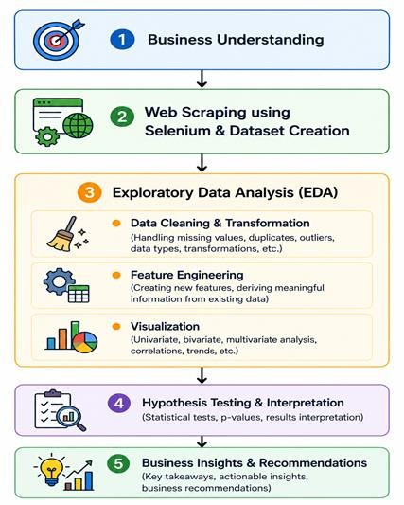
Project Flow

Slide 7
Dataset Overview
Project_name | Name of the residential real estate project
status | Current project status or construction status
completion_date | Expected or scheduled project completion date
Bhk | Number of bedrooms, hall, and kitchen
property_type | Type of property, such as apartment or villa
location | Area or locality where the property is situated
city | City where the property is located
price | Listed property price in Indian rupees
area_sqft | Property area measured in square feet
builder | Name of the real estate builder or developer
rera_number | Real Estate Regulatory Authority (RERA) registration number
booking_status | Booking availability or current booking status
offer | Special offers or discounts mentioned in the listing
description | Text describing the property and its features
raw_details | Original extracted property details scraped from the website

Slide 8
Project Steps and Screenshots
Data Preprocessing
Checked dataset structure using:
  .info()
  .describe()
  .isnull()
Handled missing values using:
  Median, Mean, Mode
Removed duplicate records
Converted columns into proper data types
Detected outliers using:
  Z-Score Method
  IQR Method

Slide 9
Feature Engineering
New Features Created:
1. Price Category
Categorized properties based on their listed price.
Categories: Budget (₹0–50 Lakhs), Mid-Range (₹50 Lakhs–1 Crore), Premium (₹1–2 Crores),
Luxury (Above ₹2 Crores).
Used to compare properties across different price segments.
2. Area Category
Grouped properties based on their area in square feet.
Helps compare small, medium, and large residential properties.
3. Project Completion Status
Used project status and completion date to understand project availability and construction progress.

Slide 10
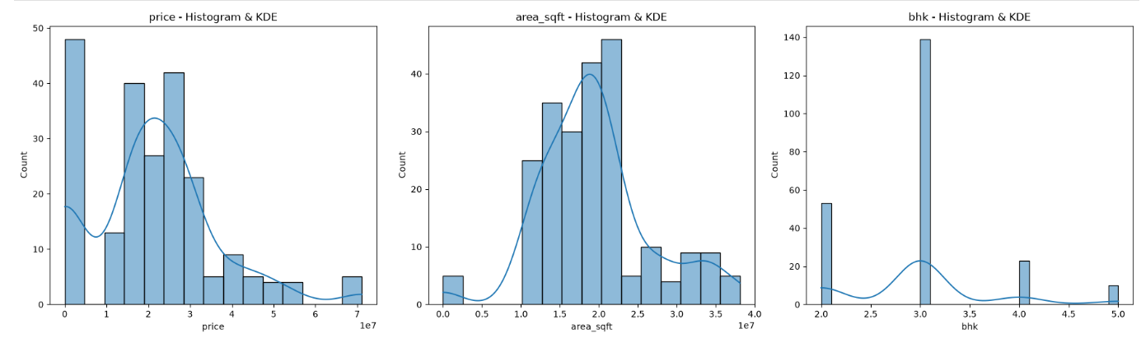
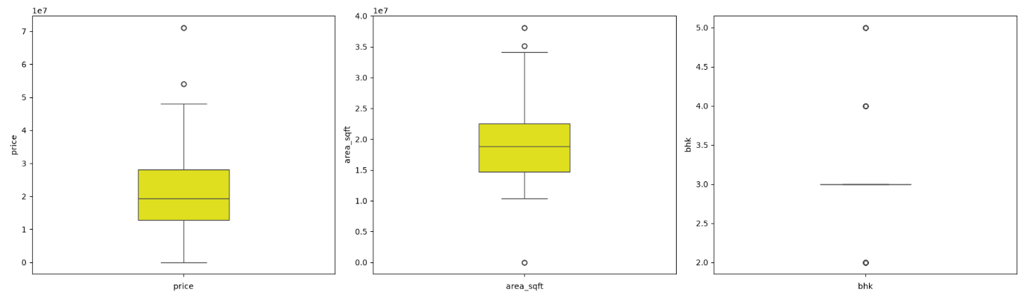
Univariate Analysis
Numerical vs Numerical
Key Findings
Property prices vary across different locations in Hyderabad.
Property sizes differ based on the type of residential property.
Different BHK configurations are available to meet buyers’ needs.
Larger properties and higher BHK configurations may have higher prices.
Outliers indicate a few properties with unusually high prices or larger areas.
The analysis helps identify property price patterns, size variations, and popular residential configurations.
Overall, the findings help buyers compare properties and make informed purchasing decisions.

Slide 11
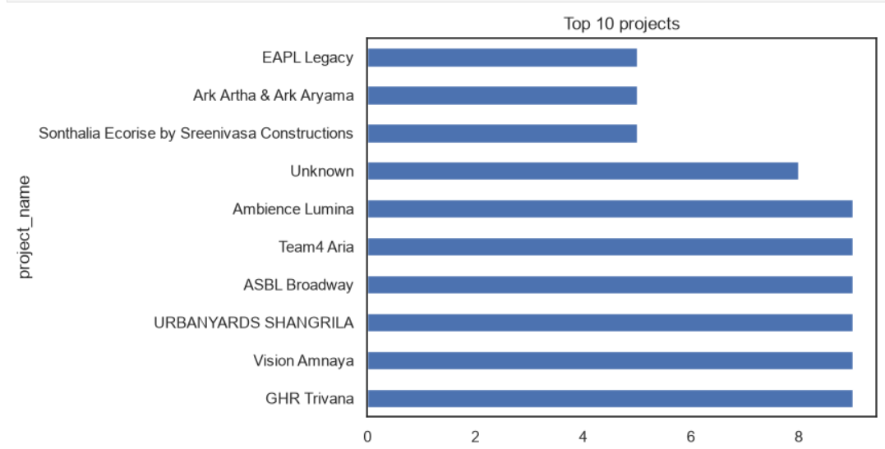
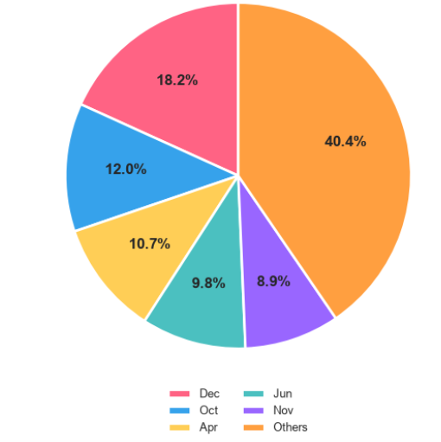
Univariate Analysis
Categorical columns
Top 10 Brands Analysis
Identified the top 10 residential projects by listing count.
Compared project representation in Hyderabad.
Highlighted projects with the most listings in the dataset.
Monthly Distribution
  The “Others” category dominates with 40.4%, followed by December (18.2%) and October (12%). The distribution highlights the dominance of a few categories, while the remaining categories contribute smaller shares.

Slide 12
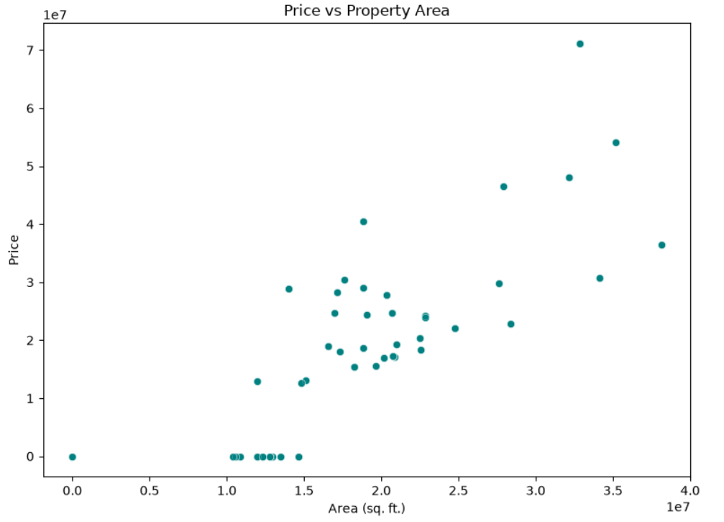
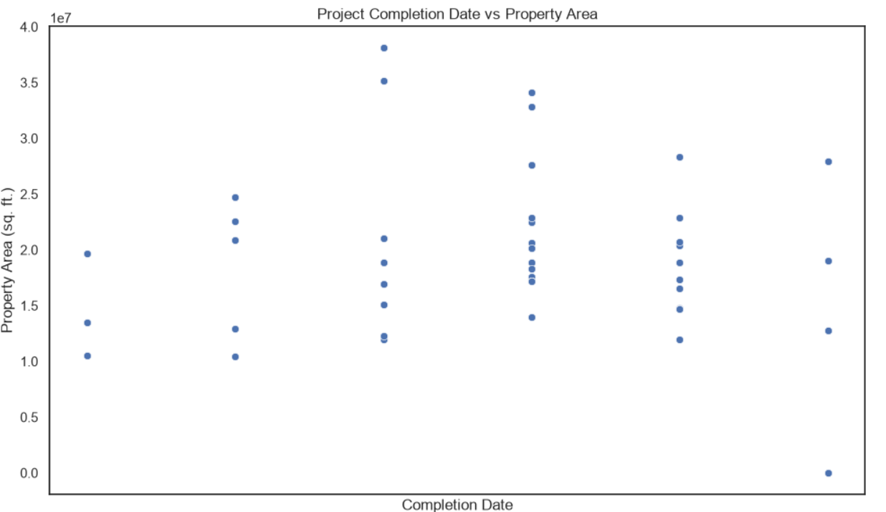
Bivariate Analysis
Numerical vs Numerical
Examines the relationship between project completion dates and property sizes.
Shows how property area varies across different completion timelines.

Slide 13
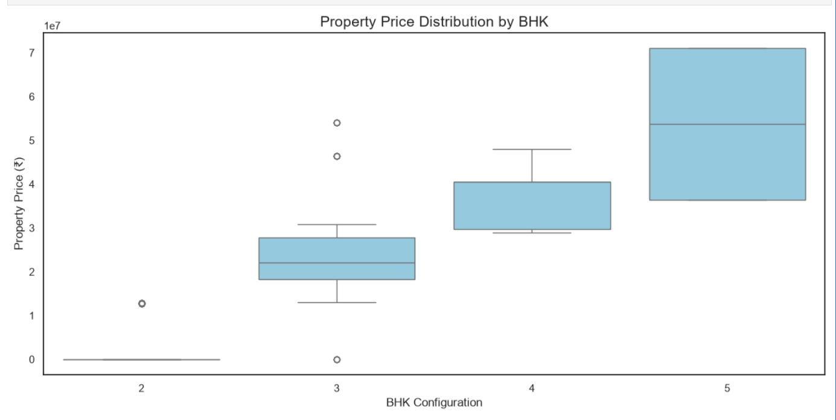
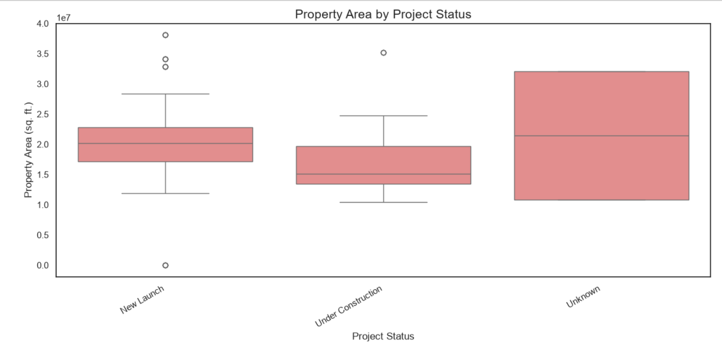
Bivariate Analysis
Categorical vs Numerical
Analyses how property prices vary across different BHK configurations, highlighting differences in median prices and price distribution.
Examines how property sizes vary across project statuses, highlighting differences in median area and the distribution of property sizes.

Slide 14
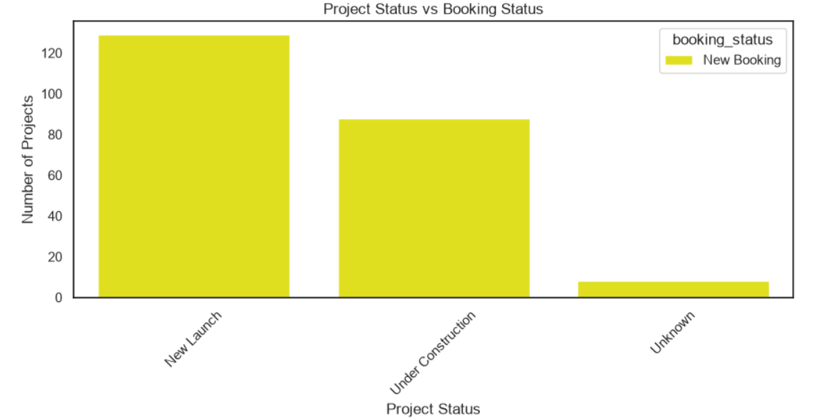
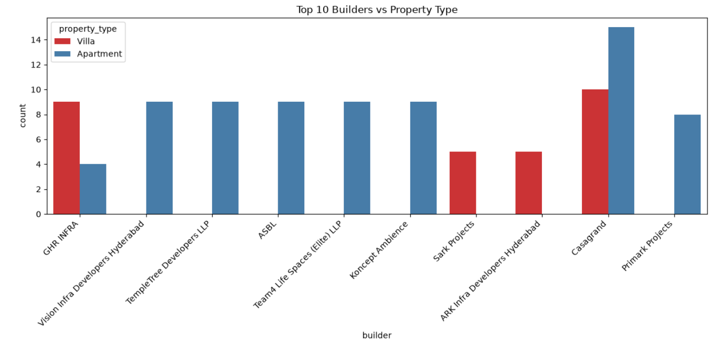
Bivariate Analysis
Categorical vs Categorical
Top 10 Builders vs Property Type: Identifies the top 10 builders and compares the number of properties offered by each property type.
Project Status vs Booking Status: Analyses the relationship between project completion status and booking availability to understand the booking distribution across projects.

Slide 15
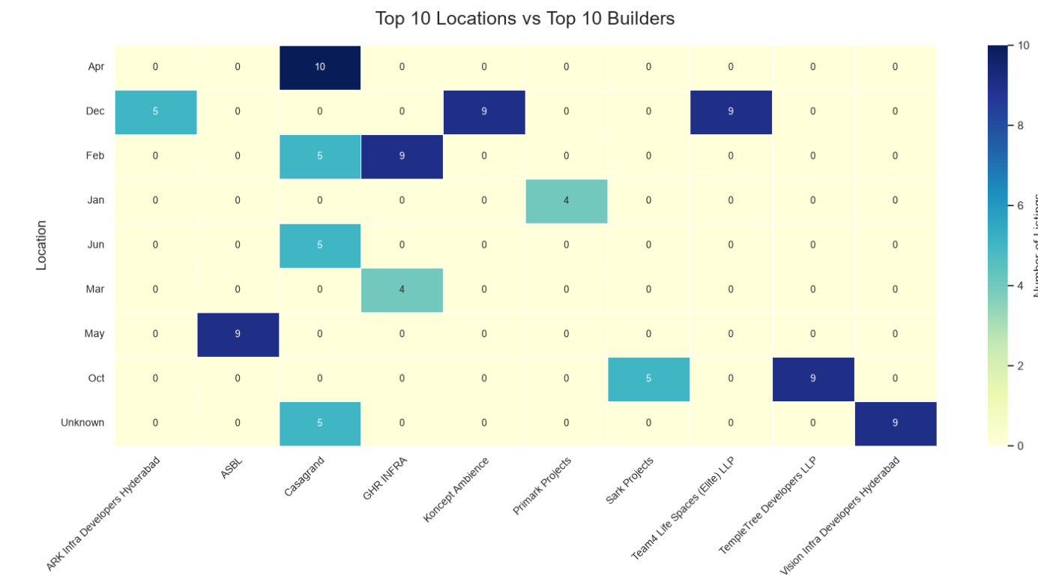
Multivariate Analysis
Compares the distribution of property listings across the top 10 locations and top 10 builders.
Highlights which builder–location combinations have the highest number of listings in the dataset.

Slide 16
Hypothesis Testing
1. Does BHK Configuration Affect Property Pricing?
Null Hypothesis (H₀): BHK configuration has no significant difference in average property prices.
Alternative Hypothesis (H₁): At least one BHK configuration has a significantly different average price.
Variables: BHK (Categorical) vs Price (Numerical) — One-Way ANOVA Test
Result: Reject H₀ if p-value < 0.05.
Conclusion: If statistically significant, property prices differ across at least some BHK configurations.
2. Does Property Area Relate to Property Pricing?
Null Hypothesis (H₀): Property area has no significant linear correlation with price.
Alternative Hypothesis (H₁): Property area has a significant linear correlation with price.
Variables: Area (Numerical) vs Price (Numerical) — Pearson Correlation Test
Result: Reject H₀ if p-value < 0.05.
Conclusion: If statistically significant, property area and price have a linear relationship. The correlation may be positive or negative.

Slide 17
Business Insights and Recommendations
Business Insights
Property Pricing: Property prices vary across BHK configurations, property types, and locations.
Popular Projects: Identified the top 10 projects and builders based on listing counts.
Location Analysis: Compared property listings across Hyderabad localities to understand their distribution.
Property Size: Analyzed the relationship between property area and price.
Booking Status: Compared project status with booking status to understand listing availability.
Recommendations
For Buyers: Compare prices, BHK configurations, and property sizes before selecting a property.
For Investors: Explore locations and projects with promising features and suitable price ranges.
For Builders: Analyze listing distribution across locations and property types to identify potential market opportunities.
For Budget Planning: Use price categories to shortlist properties within a preferred budget.
For Verification: Check RERA registration details, project completion dates, and booking availability before making a purchase.

Slide 18
Conclusion
Successfully collected and analysed residential property listings from 99acres for Hyderabad.
Explored property price trends, BHK configurations, property types, locations, and builders using Python and EDA.
Used visualizations and statistical tests to investigate relationships between property area, BHK configuration, and pricing.
Derived business insights to help buyers compare properties and support informed real estate investment decisions.

Slide 19



Slide 20


